Slide 1

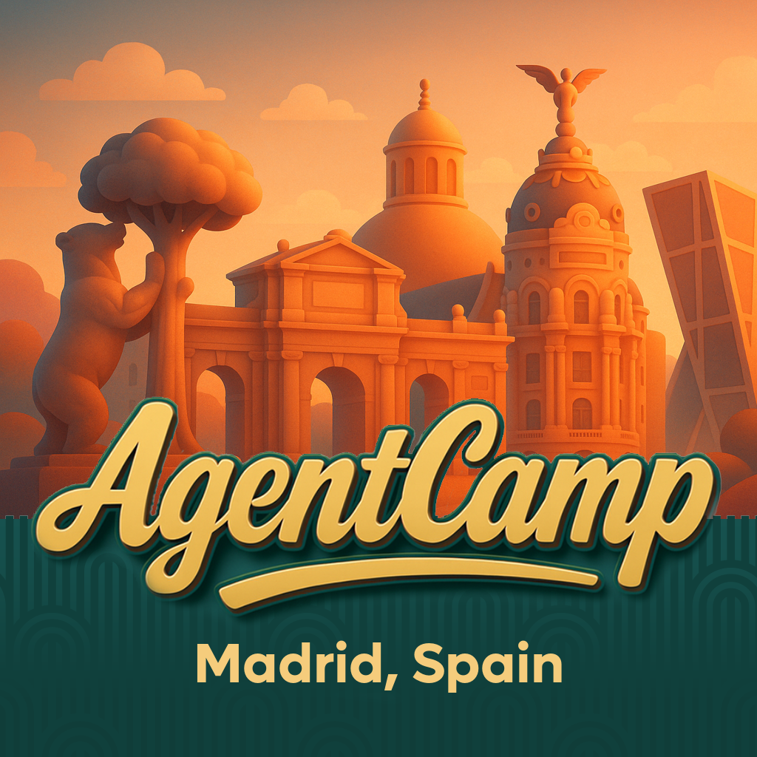



28 Febrero 2026
09:00 AM – 18:00 PM CST
CEU San Pablo
Madrid, Spain
https://globalai.es/
#AgentCamp #GlobalAICommunity

Slide 2

Agentes Dapr y Foundry AI para NPCs inteligentes
#AgentCamp #GlobalAICommunity

Slide 3


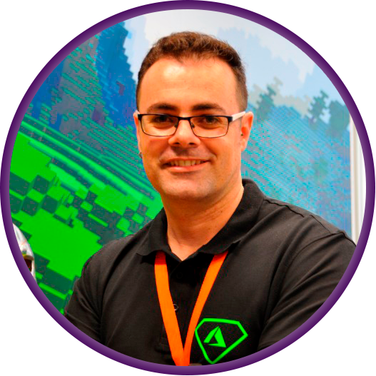

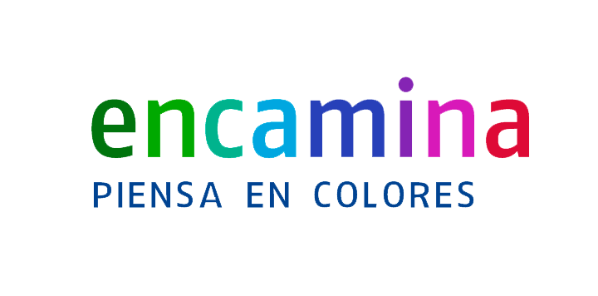

Hello!
Santiago Porras Rodríguez
Sergio Parra Guerra
Santiago Parra
ENCAMINA
@saintwukong
ENCAMINA
@sparraguerra
ENCAMINA

Slide 4













¡Gracias a nuestros Patrocinadores!
PREMIUM
GOLD
Colaboradores:

Slide 5

Join the AI Conversation on Discord
gaic.io/discord

Slide 6

Agenda
Quick Overview of Dapr
Overview of Dapr Agents and its key features
Understanding the benefits and use cases for Dapr Agents
Common design patterns and use cases for building agentic systems
Demo

Slide 7

Quick overview of Dapr

Slide 8
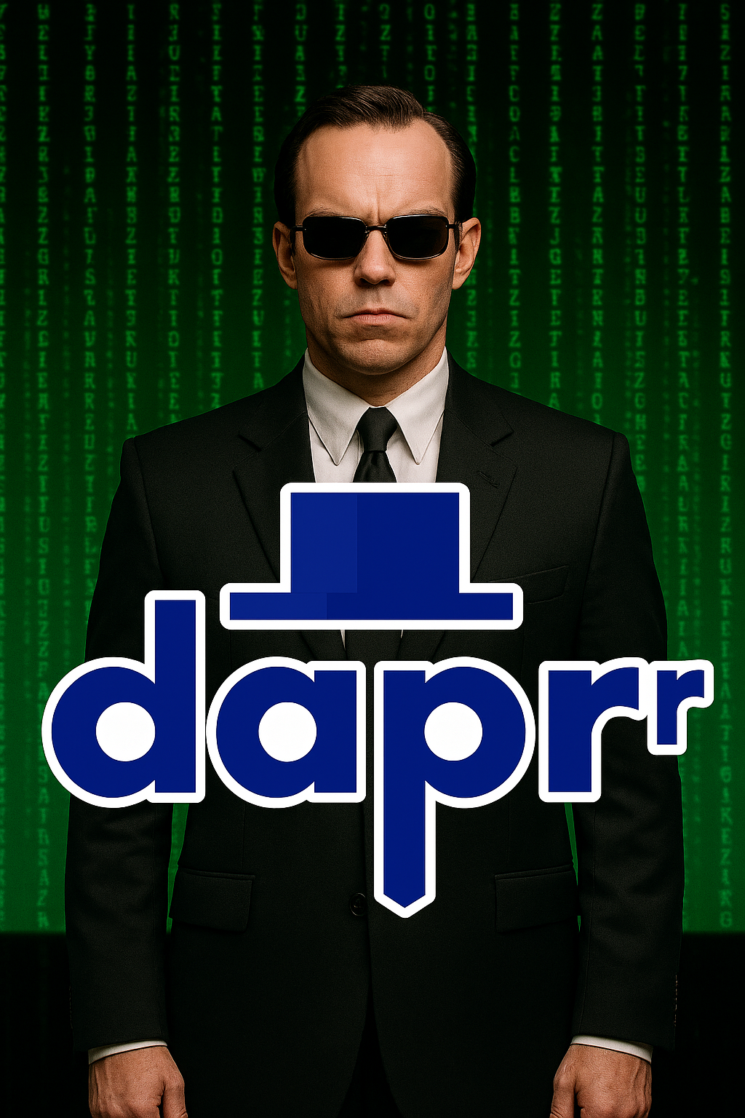
Overview of Dapr Agents and its key features

Slide 9
Definition
Dapr Agents is a developer framework for building durable and resilient AI agent systems powered by Large Language Models (LLMs).
It includes built-in observability and stateful workflow execution to ensure agentic workflows complete successfully, regardless of complexity.

Slide 10
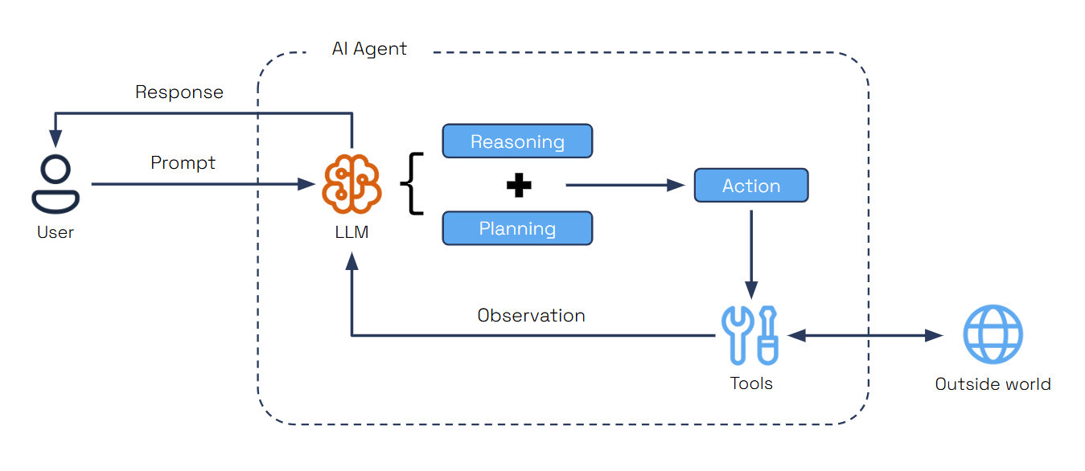
Notes:
Agents are autonomous units powered by Large Language Models (LLMs), designed to execute tasks, reason through problems, and collaborate within workflows. Acting as intelligent building blocks, agents combine reasoning with tool integration, memory, and collaboration features to get to the desired outcome.
Dapr Agents is a developer framework for building durable and resilient AI agent systems powered by Large Language Models (LLMs).
Dapr Agents provides a structured way to build, deploy, and orchestrate applications that use LLMs like OpenAI's GPT models, without getting bogged down in implementation details. The primary goal is to make AI
development more accessible by abstracting away the complexities of working with LLMs, tools, memory management, and distributed systems, allowing developers to focus on the business logic of their AI applications.

Slide 11
Core Capabilities
Agent Identity
Durable Execution
Resilience
Scale and Efficiency
Data-Driven Agents
Multi-Agent Systems
Vendor-Neutral & Open Source
Notes:
Core Capabilities
Agent Identity: With Dapr Agents, each agent is assigned a unique cryptographic identity that is used to authenticate agent interactions and enforce authorization across services and infrastructure.
Durable Execution: Agents created with Dapr Agents are backed by Dapr’s workflow engine, which persists every agent interaction with LLMs and tools into a durable state store that can recover and continue execution even after the agent restarts.
Resilience: Dapr Agents can recover from transient failures with automatic retry policies, timeouts, and circuit breakers, and can also apply durable retries backed by workflow state to recover from longer-lasting failures.
Scale and Efficiency: Run thousands of agents efficiently on a single core. Dapr distributes single and multi-agent apps transparently across fleets of machines and handles their lifecycle.
Data-Driven Agents: Directly integrate with databases, documents, and unstructured data by connecting to dozens of different data sources.
Multi-Agent Systems: Secure and observable by default, enabling collaboration between agents.
Kubernetes-Native: Easily deploy and manage agents in Kubernetes environments.
Platform-Ready: Access scopes and declarative resources enable platform teams to integrate Dapr Agents into their systems.
Vendor-Neutral & Open Source: Avoid vendor lock-in and gain flexibility across cloud and on-premises deployments.

Slide 12
Key Features
LLM Integration
Tool Selection
MCP Support
Memory Management
Durable Agents
Event-Driven Communication
Agent Orchestration
Notes:
Key Feature
LLM Integration: It abstracts the LLM inference API for chat completion using the Dapr Conversation API, enabling you to swap LLM providers without changing high-level agent code, and includes native clients for embeddings, audio, and other specialized integrations.
Tool Selection: Dynamic tool selection based on requirements, best action, and execution through Function Calling capabilities.
MCP Support: Built-in support for Model Context Protocol enabling agents to dynamically discover and invoke external tools through standardized interfaces.
Memory Management: Retain context across interactions with options from simple in-memory lists to vector databases, integrating with Dapr state stores for scalable, persistent memory.
Durable Agents: Workflow-backed agents that provide fault-tolerant execution with persistent state management and automatic retry mechanisms for long-running processes.
Agent Runner: Expose agents over HTTP or subscribe to a PubSub for long-running tasks, enabling API access to agents without requiring a user interface or human intervention.
Event-Driven Communication: Enable agent collaboration through Pub/Sub messaging for event-driven communication, task distribution, and real-time coordination in distributed systems.
Agent Orchestration: Deterministic agent orchestration using Dapr Workflows with higher-level tasks that interact with LLMs for complex multi-step processes.

Slide 13
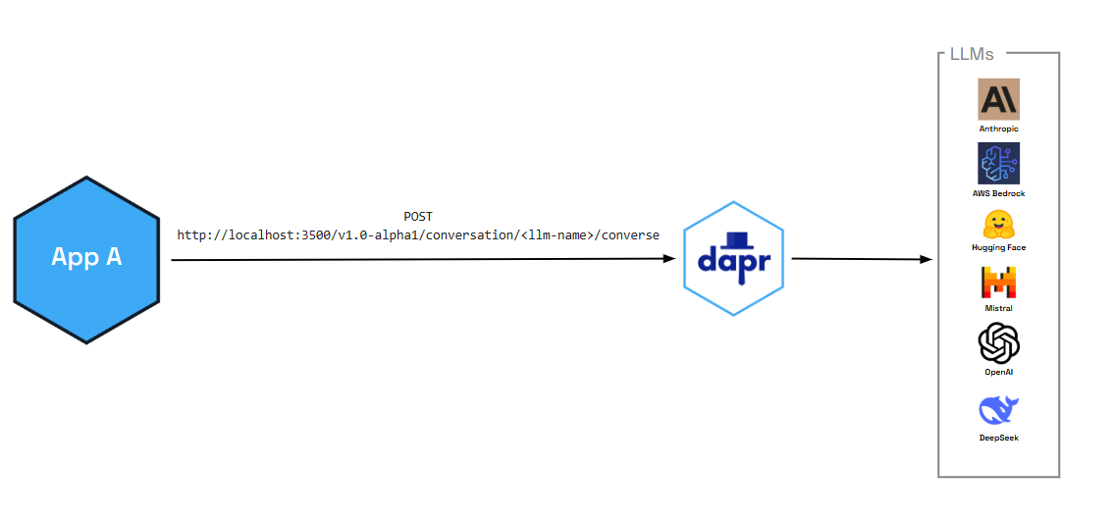
LLM Integration
Notes:
Dapr Agents provides a unified interface to connect with LLM inference APIs.
This abstraction allows developers to seamlessly integrate their agents with cutting-edge language models for reasoning and decision-making. The framework includes multiple LLM clients for different providers and modalities:

Slide 14
LLM Integration
Provider Flexibility: Switch between different LLM providers (OpenAI, Anthropic, Azure, etc.) by simply changing component configuration, without modifying your code.
Caching: Dapr can cache responses for identical prompts, reducing costs and latency.
PII Obfuscation: Personal identifiable information (such as phone number, email address, social security number, etc) can be automatically removed from prompts and responses.
Resiliency: Built-in or custom-defined retry policies, timeouts, and circuit breakers make your applications more robust against LLM service outages.
Tracing: Dapr's observability features help you monitor and debug LLM interactions.
Secret Management: API keys can be securely retrieved through Dapr's secret store rather than in the application or component code.
Notes:
Dapr Agents provides a unified interface to connect with LLM inference APIs.
This abstraction allows developers to seamlessly integrate their agents with cutting-edge language models for reasoning and decision-making. The framework includes multiple LLM clients for different providers and modalities:

Slide 15
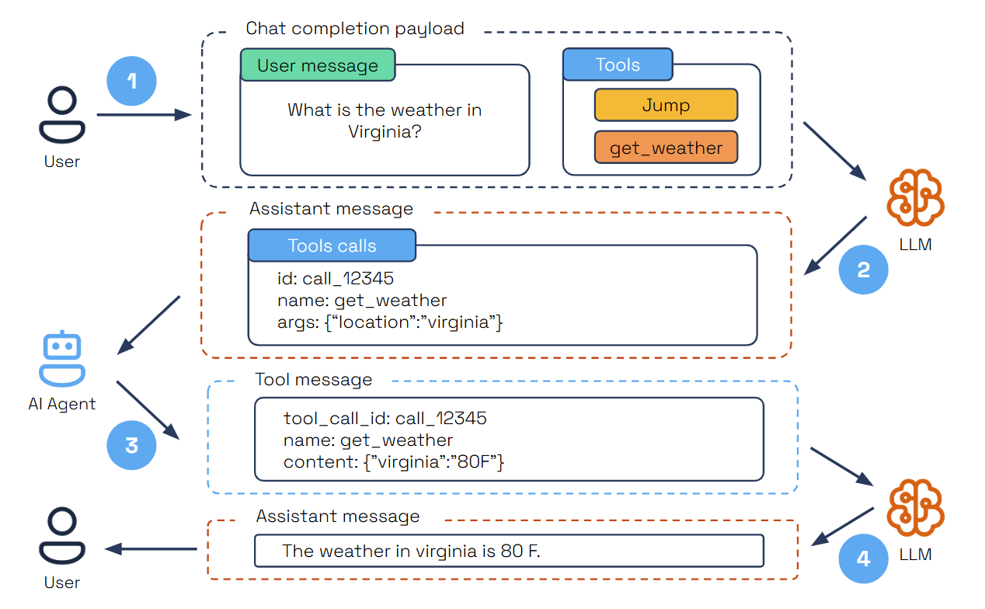
Tool Selection/Calling
Notes:
Tool Calling is an essential pattern in autonomous agent design, allowing AI agents to interact dynamically with external tools based on user input. Agents dynamically select the appropriate tool for a given task, using LLMs to analyze requirements and choose the best action.
The user submits a query specifying a task and the available tools.
The LLM analyzes the query and selects the right tool for the task.
The LLM provides a structured JSON output containing the tool’s unique ID, name, and arguments.
The AI agent parses the JSON, executes the tool with the provided arguments, and sends the results back as a tool message.
The LLM then summarizes the tool’s execution results within the user’s context to deliver a comprehensive final response.

Slide 16
MCP Support
What is MCP?
The Model Context Protocol (MCP) is a standard for connecting AI agents to external tools and systems. MCP allows agents to:
Discover and use tools provided by other processes or services
Communicate with tools over different transports (local or networked)
Integrate with databases, APIs, scripts, and more
Key Concepts
Before diving into the code, let's cover the key concepts:
MCP Server: A process that exposes tools using the MCP protocol. This could be a script, a database connector, or any service that implements MCP.
MCP Client: A component that connects to an MCP server, discovers its tools and makes them available to agents.
Transports: MCP supports multiple ways to connect:
STDIO: Communicates over standard input/output (local subprocess, no network needed). Great for local development and testing.
SSE (Server-Sent Events): Communicates over HTTP for distributed or networked tools.

Slide 17
MCP Support
Agents dynamically select the appropriate tool for a given task, using LLMs to analyze requirements and choose the best action. This is supported directly through LLM parametric knowledge and enhanced by Function Calling, ensuring tools are invoked efficiently and accurately.
Dapr Agents includes built-in support for the Model Context Protocol (MCP), enabling agents to dynamically discover and invoke external tools through a standardized interface. This allows agents to incorporate capabilities exposed by external processes without hardcoding or preloading them.

Slide 18
Memory Management
Agents retain context across interactions, enhancing their ability to provide coherent and adaptive responses. Memory options range from simple in-memory lists for managing chat history to vector databases for semantic search and retrieval.
Dapr Agents also integrates with all available Dapr state stores, enabling scalable and persistent memory for advanced use cases. These state stores can be used interchangeably as chat memory and easily swapped out as needed.
Notes:
Agents retain context across interactions, enhancing their ability to provide coherent and adaptive responses.
Memory options range from simple in-memory lists for managing chat history to vector databases for semantic search, and also integrates with Dapr state stores, for scalable and persistent memory for advanced use cases from 28 different state store providers.

Slide 19
Durable Agents
Workflow-native agent for coordinating multi-turn conversations and tool execution. Designed for stateful, resilient, and routable agent workflows with built-in durability.
Key Characteristics:
Workflow-based execution using Dapr Workflows
Persistent workflow state management across sessions and failures
Automatic retry and recovery mechanisms
Deterministic execution with checkpointing
Built-in message routing and agent communication
Automatic Recovery: Resume from failures without losing progress
Scalability: Distribute agent workloads across multiple nodes
Supports complex orchestration patterns and multi-agent collaboration
When to use:
Multi-step workflows that span time or systems
Tasks requiring guaranteed progress tracking and state persistence
Scenarios where operations may pause, fail, or need recovery without data loss
Complex agent orchestration and multi-agent collaboration
Production systems requiring fault tolerance and scalability

Slide 20
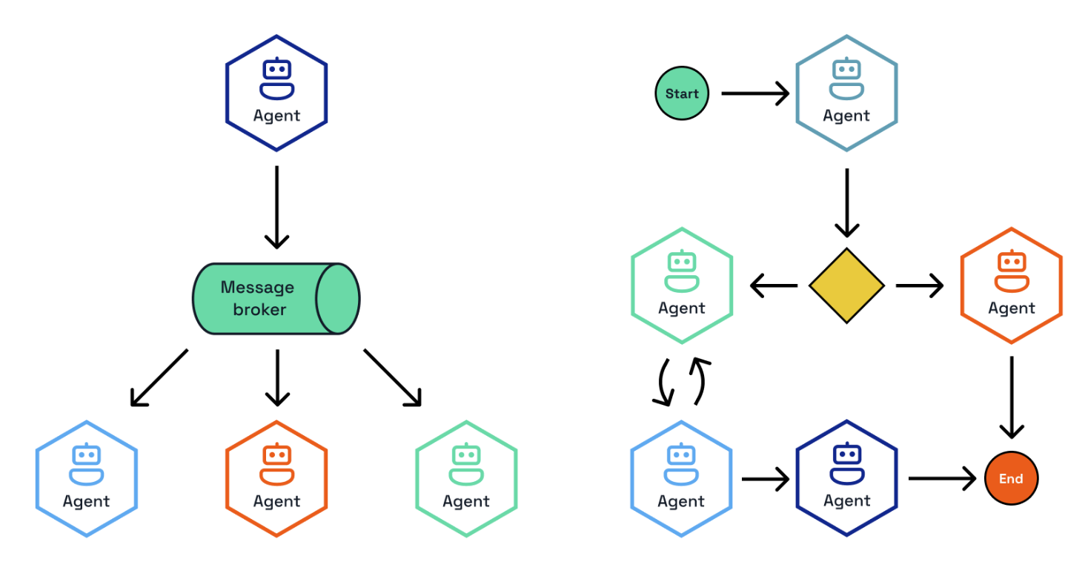
Event-Driven Communication and Agent Orchestration
Notes:
Event-driven agent orchestration enables multiple specialized agents to collaborate through asynchronous Pub/Sub messaging. This approach provides powerful collaborative problem-solving, parallel processing, and division of responsibilities among specialized agents through independent scaling, resilience via service isolation, and clear separation of responsibilities.
The orchestrator coordinates interactions between agents and manages conversation flow by selecting appropriate agents, managing interaction sequences, and tracking progress. Dapr Agents offers three orchestration strategies: Random, RoundRobin, and LLM-based orchestration.

Slide 21
Understanding the benefits and use cases for Dapr Agents

Slide 22
Benefits of Dapr Agents
Agent-Centric Model
LLM-Powered Intelligence: Leverage LLMs for reasoning, dynamic decision-making, and natural language interactions
Complete API Surface: Provides a comprehensive toolkit to address common AI problems with support for tool calling and reasoning loops (e.g., ReAct)
Actor-Based Architecture
Stateful & Efficient: Agents process one task at a time, avoiding concurrency issues while maintaining state
Cost-Effective Scaling: Reliably runs thousands of agents on a single core with the ability to scale to zero when idle

Slide 23
Benefits of Dapr Agents
Workflow-Oriented Design
Execution Guarantees: Ensures each agent task is completed successfully despite failures or interruptions
Versatile Interactions: Supports both deterministic workflows and event-driven, message-based communication
Business-Critical Operations: Built for durable, long-running processes on top of the actor model
Decoupled Infrastructure
Clean Separation: Agents operate independently from the underlying infrastructure components
Simplified Integrations: Built-in connectivity to enterprise data sources
Technology Flexibility: Easily switch between databases (Postgres, MySQL, AWS DynamoDB) or message brokers (Kafka, MQTT)

Slide 24
Benefits of Dapr Agents
Enterprise-Ready & Vendor-Neutral
Built on Dapr: Leverages a trusted enterprise framework with observability, security, and resiliency at scale
CNCF Foundation: Part of the Cloud Native Computing Foundation ecosystem, eliminating vendor lock-in risks

Slide 25
Common design patterns and use cases for building agentic systems

Slide 26
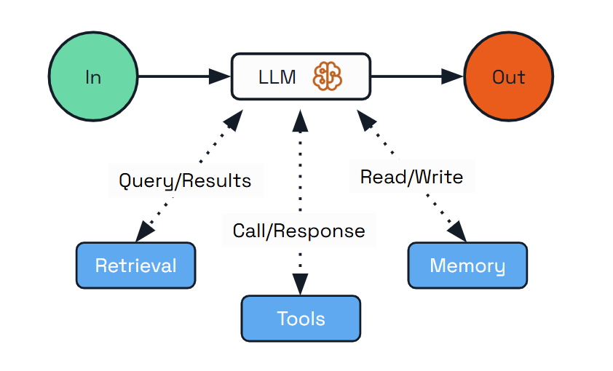
Pattern 1: Augmented LLM
Scenarios where you need an LLM with enhanced capabilities but don’t require complex orchestration or autonomous decision-making.
Use Cases:
Personal assistants that remember user preferences.
Customer support agents that access product information.
Research tools that retrieve and analyze information.

Slide 27
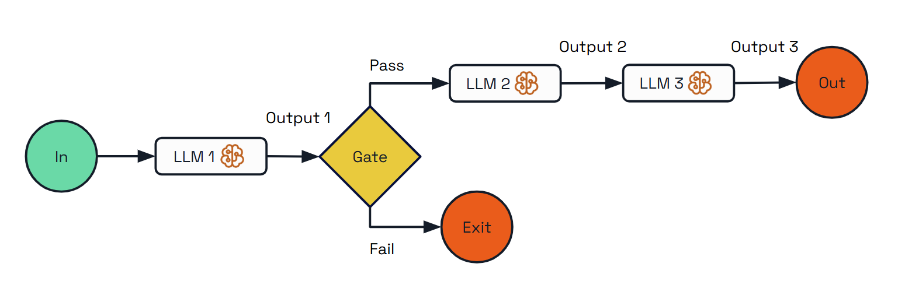
Pattern 2: Prompt Chaining
Decomposing tasks into a sequence of steps, where each LLM call processes the output of the previous one.
Use Cases:
Resource optimization (sending simple queries to smaller models).
Multi-lingual support (routing queries to language-specific handlers).
Customer support (directing different query types to specialized handlers).
Content creation (routing writing tasks to topic specialists).
Hybrid LLM systems (using different models for different tasks).

Slide 28
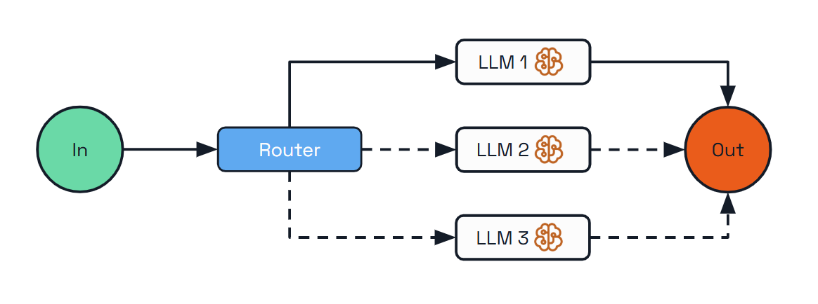
Pattern 3: Routing
Addresses diverse request types by classifying inputs and directing them to specialized follow-up tasks.
Use Cases:
Content generation (creating outlines first, then expanding, then reviewing).
Multi-stage analysis (performing complex analysis into sequential steps).
Quality assurance workflows (adding validation between processing steps).

Slide 29
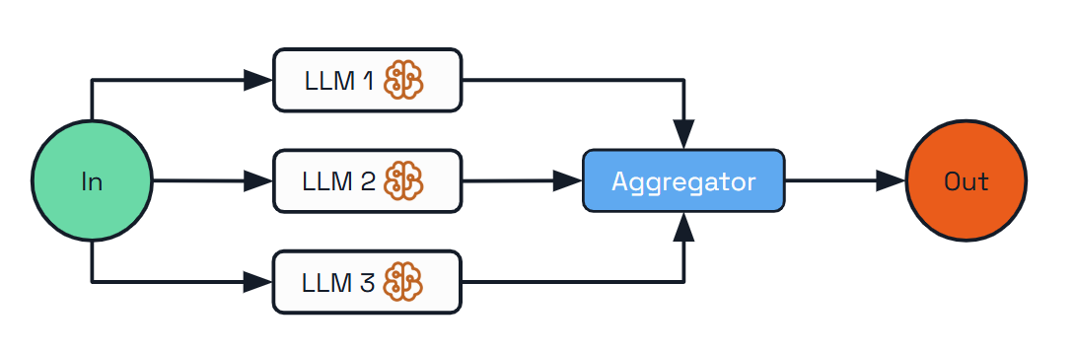
Pattern 4: Parallelization
Enables processing multiple dimensions of a problem simultaneously, with outputs aggregated programmatically.
Use Cases:
Complex research (processing different aspects of a topic in parallel).
Multi-faceted planning (creating various elements of a plan concurrently).
Product analysis (analyzing different aspects of a product in parallel).
Content creation (generating multiple sections of a document simultaneously).

Slide 30
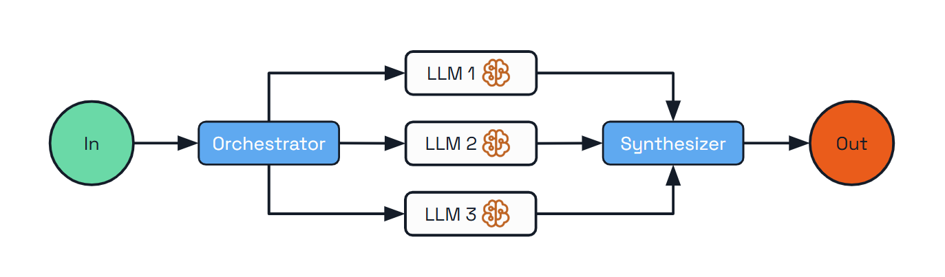
Pattern 5: Orchestrator-Workers
A central orchestrator LLM that dynamically breaks down tasks, delegates them to worker LLMs, and synthesizes their results.
Use Cases:
Software development tasks spanning multiple files.
Research gathering information from multiple sources.
Business analysis evaluating different facets of a complex problem.
Content creation combining specialized content from various domains.

Slide 31
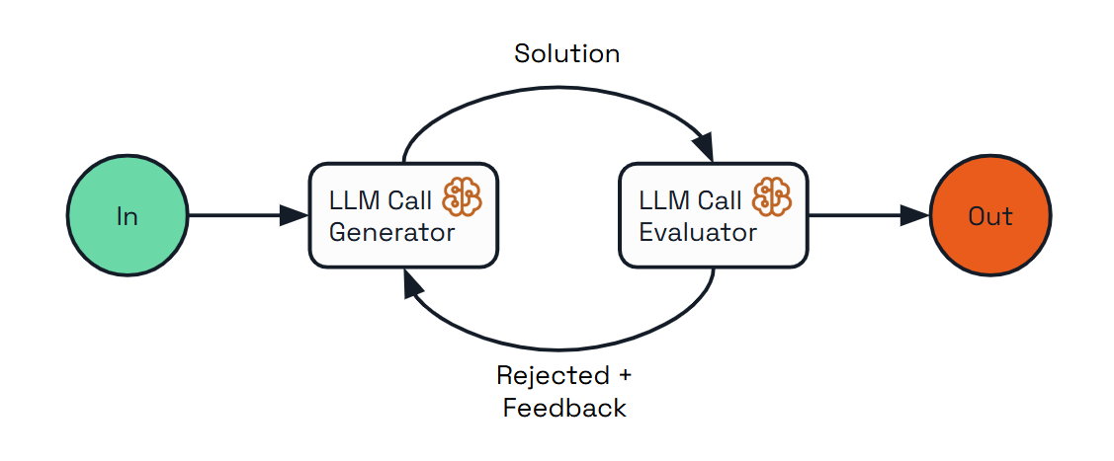
Pattern 6: Evaluator-Optimizer
Implements a dual-LLM process where one model generates responses while another provides evaluation and feedback in an iterative loop.
Use Cases:
Content creation requiring adherence to specific style guidelines.
Translation needing nuanced understanding and expression.
Code generation meeting specific requirements and handling edge cases.
Complex search requiring multiple rounds of information gathering and refinement.

Slide 32
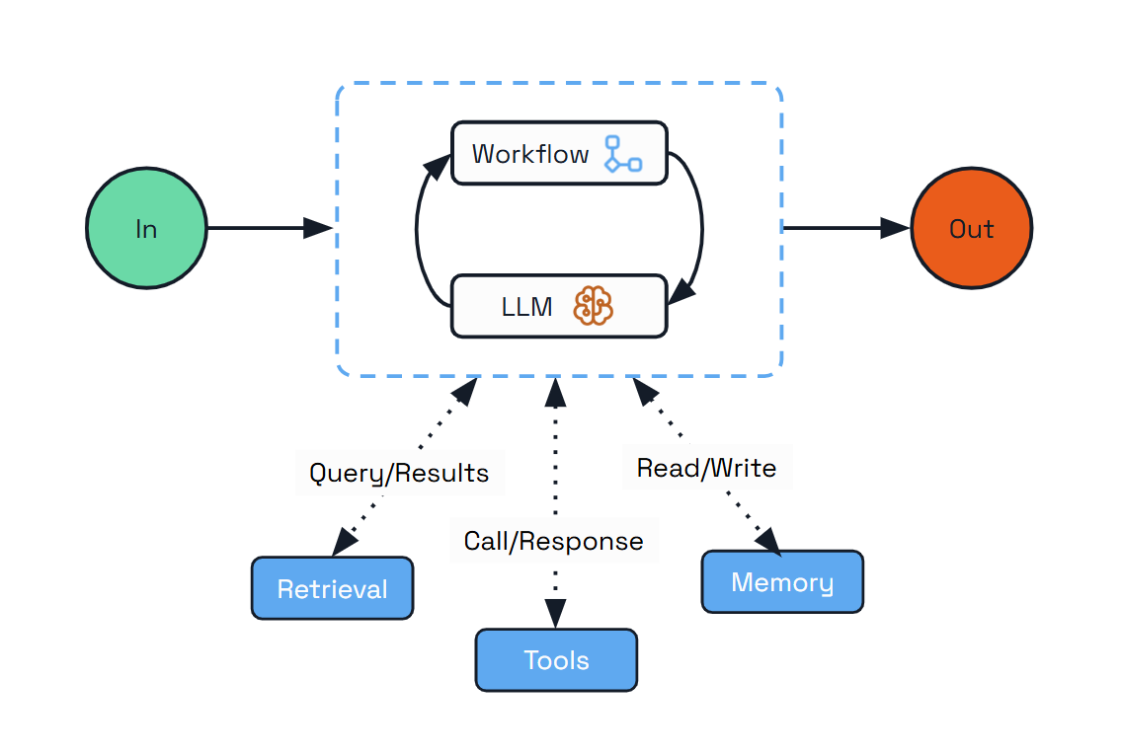
Pattern 7: Durable Agent
Dynamically creates workflows with durable activities for each interaction, where LLM calls and tool executions are stored reliably in Dapr’s state stores
Use Cases:
Long-running tasks that may take minutes or days to complete.
Distributed systems running across multiple services.
Customer support handling complex multi-session tickets.
Business processes with LLM intelligence at each step.
Personal assistants handling scheduling and information lookup.
Autonomous background processes triggered by external systems.

Slide 33
DEMO TIME!!!

Slide 34
¡Gracias!
https://globalai.es/
#AgentCamp #GlobalAICommunity

Slide 35
¡Gracias a nuestros Patrocinadores!
PREMIUM
GOLD
Colaboradores:

